Slide 1

Customer Churn Diagnostic
Uncovering Subscriber Defection Patterns, Revenue Risks, and Strategic Retention Roadmaps for Airtel

Slide 2

Executive Diagnostics
Empirical investigation across 7,043 subscriber accounts to pinpoint root drivers of cancellation and safeguard market share.

Slide 3

The Customer Churn Landscape
26.5%
Substantial Revenue Leakage
Out of 7,043 active telecom subscribers, 1,869 churned, leading to an estimated $1.4M+ in monthly recurring revenue loss.
Acquiring a replacement subscriber costs 5x to 7x more than retaining an existing user, making targeted retention Airtel's single highest ROI initiative.
Overall Customer Churn Rate

Slide 4
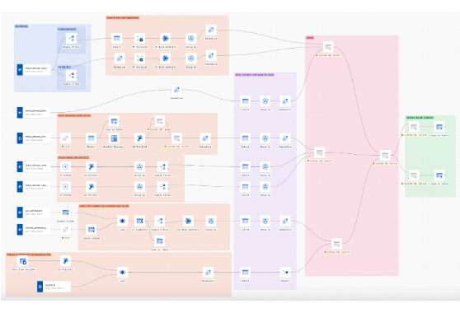
Dataset & Analytics Scope
7,043 Customer Profiles: Multi-dimensional tracking covering demographic, billing, and behavioral attributes.
Account Variables: Evaluating contract terms (Month-to-month vs 1/2 Yr), payment methods, and monthly charges.
Service Subscriptions: Analyzing fiber optic internet, DSL, tech support, online security, and streaming add-ons.

Slide 5


Primary Attrition Catalysts
1. Contract & Payment Friction
2. Fiber Optic Price Disconnect
Subscribers on Month-to-Month contracts exhibit a staggering 42.7% churn rate. Furthermore, users paying via Electronic Check churn at 45.2%, reflecting low commitment and billing friction.
Fiber Optic users churn at 41.9% (vs 19.0% for DSL). Higher monthly bills ($70–$110) combined with missing technical support create perceived value mismatch and dissatisfaction.

Slide 6






Core Behavioral Churn Drivers
Early Tenure Risk
Missing Security
High Bill Sensitivity
50%+ of all churn occurs within the first 12 months of tenure. New subscribers lack brand stickiness and easily switch to rival promos.
Customers without Online Security or Tech Support churn at 3x the rate of fully protected subscribers (41% vs 14%).
Subscribers with monthly bills exceeding $70/month show steep churn spikes, especially when unbundled from long-term contracts.

Slide 7
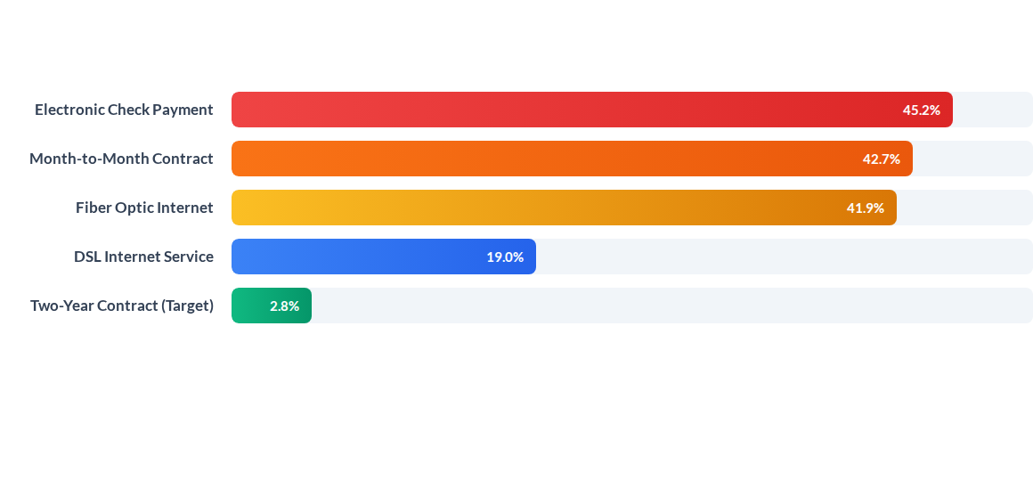
Churn Comparison Across Segments
Moving subscribers from Month-to-Month Electronic Check plans into 1-Year or 2-Year Auto-Pay contracts reduces churn risk by over 80%.

Slide 8
High-Risk Customer Segment Matrix
Customer Segment Profile | Churn Rate | Avg Monthly Bill | Primary Risk Driver | Risk Level
Fiber Optic + Month-to-Month | 54.6% | $88.50 | High cost, low contract lock-in | Critical
Electronic Check + No Tech Support | 48.1% | $74.20 | Payment friction & unassisted issues | Critical
Tenure < 12 Months (New Users) | 47.4% | $65.80 | Lack of onboarding & brand loyalty | High
DSL + One-Year Contract | 11.2% | $49.10 | Moderate cost, established lock-in | Low
Two-Year Contract (All Services) | 2.8% | $61.30 | Long-term commitment & discounts | Low

Slide 9

Support & Service Friction
Customer Care Deficit
Subscribers experiencing technical glitches who lack bundled Tech Support or Device Protection reach out to customer service up to 3x before defecting.
Proactive resolution and complimentary trial add-ons drastically improve CSAT and curb voluntary cancellation.

Slide 10




Retention Strategy Roadmap
Q2 - Auto-Pay Incentives
Q4 - Predictive AI Engine
Offer $5/mo bill credits to transition Electronic Check users to Bank Auto-Pay.
Integrate real-time ML churn scoring into call centers for proactive save offers.
Q1 - Early Onboarding
Q3 - Value Bundles
Deploy structured 90-day onboarding nudges and welcome discounts for new users.
Bundle free Tech Support & Online Security with premium Fiber Optic plans.

Slide 11



Strategic Retention Pillars
Fiber Optic Bundling
Contract Migration
AI Churn Early Warning
Protect high-ARPU Fiber users by pre-packaging free cybersecurity and family streaming perks.
Incentivize month-to-month users with annual contract discounts and automated digital payments.
Deploy machine learning models to trigger high-priority retention interventions 30 days before churn.

